Slide 1
Building Independence in Research Computing
Christina Koch
OSG School 2024
August 8, 2024

Slide 2
Learning Together

Slide 3
Overcoming Barriers
Feedback from the OSPool Advisory Group
OSG School is a great end-to-end introduction to the OSPool (and related services) but it can still be hard to know what to do next beyond the School.
A common problem beyond the OSG School
Imposter syndrome
Need for computational basics (but lack of training)
How can we help researchers feel empowered to use HTC systems with these barriers in mind?

Slide 4
Resources We Have Now
Guides/Documentation
OSPool Guides: https://portal.osg-htc.org/documentation/
HTCondor Manual: https://htcondor.readthedocs.io/en/latest/index.html
Tutorials
Tutorials on our main docs page
https://portal.osg-htc.org/documentation/htc_workloads/submitting_workloads/tutorial-command/
Or on GitHub: https://github.com/OSGConnect/
Or some default notebooks: https://notebook.ospool.osg-htc.org/
OSG School materials: https://osg-htc.org/school-2024/materials/
Videos and Slides
YouTube: https://www.youtube.com/channel/UCVxyV0Lr1KiTeq7bTw3gwLw
Training materials: https://portal.osg-htc.org/documentation/support_and_training/training/osgusertraining/

Slide 5
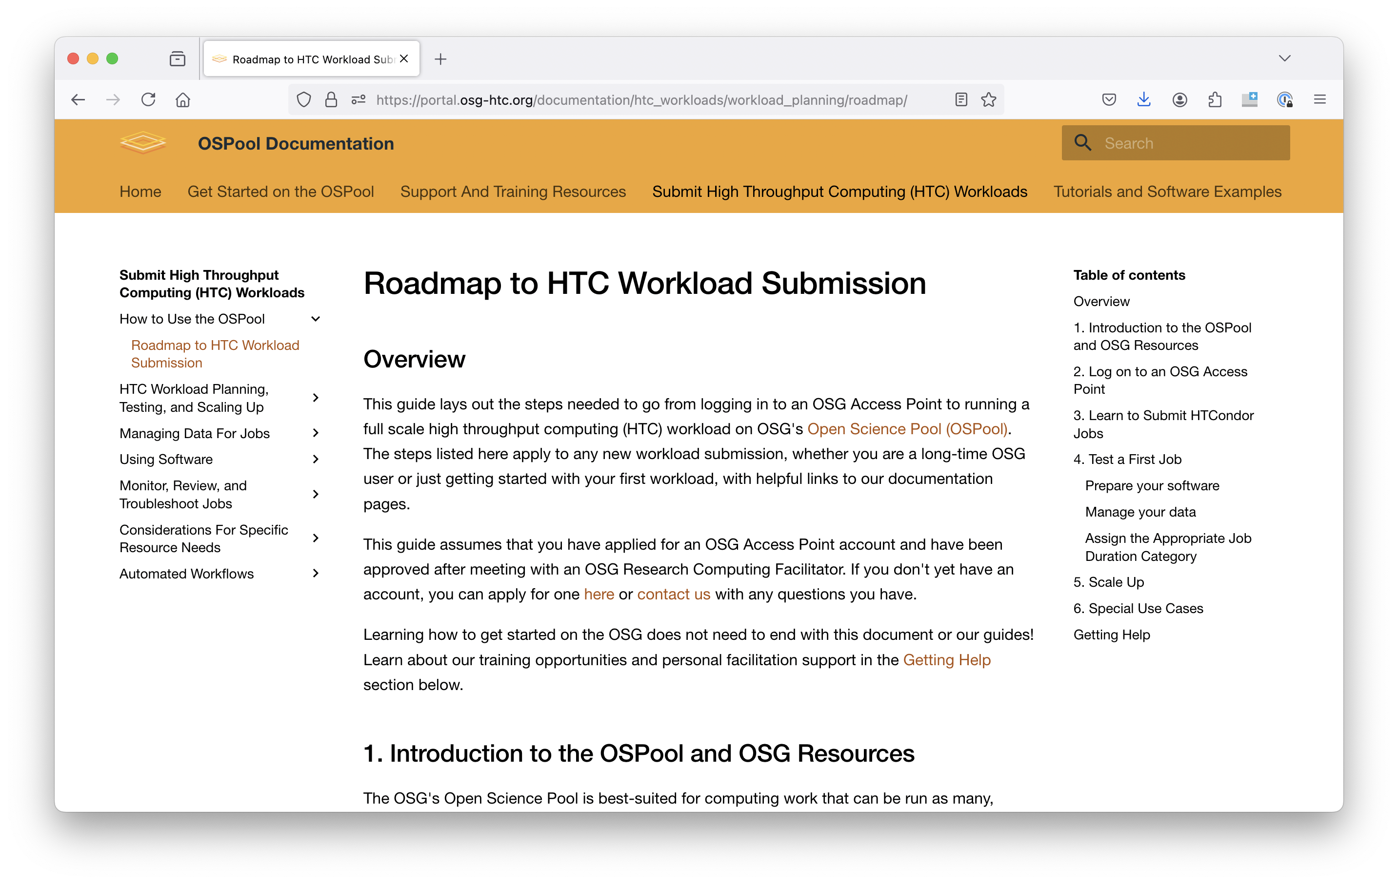
Roadmap
https://portal.osg-htc.org/documentation/htc_workloads/workload_planning/roadmap/

Slide 6
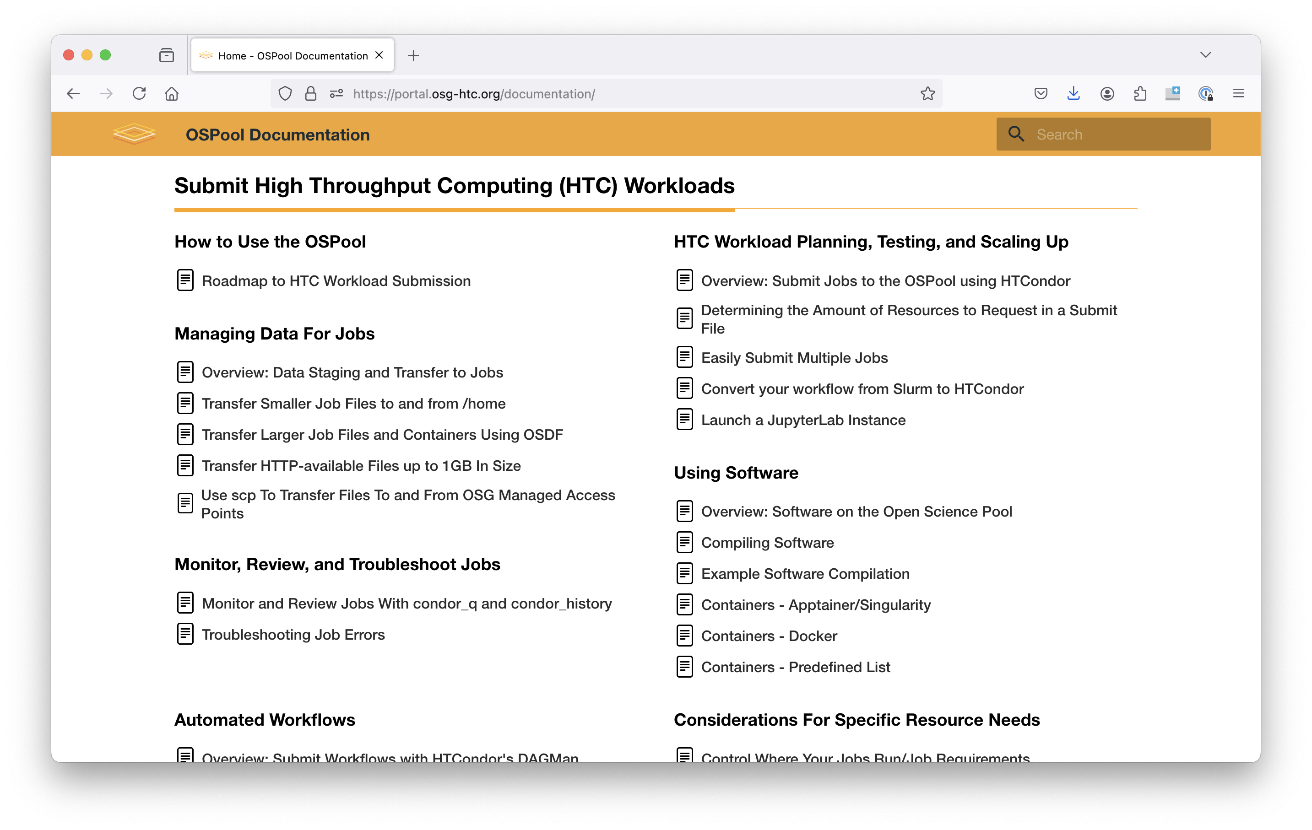
Guides by Topic
https://portal.osg-htc.org/documentation/htc_workloads/workload_planning/roadmap/

Slide 7
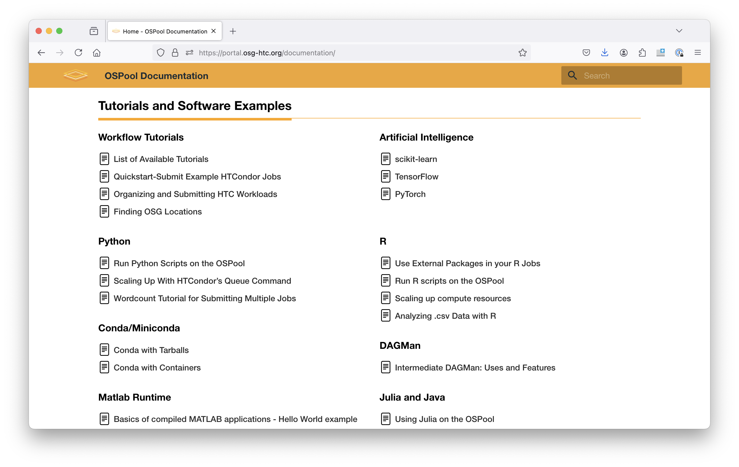
Examples and Tutorials
https://portal.osg-htc.org/documentation/htc_workloads/submitting_workloads/tutorial-command/

Slide 8
Community Support
We host:
Weekly user-focused office hours
Monthly training
OSG School (weeklong summer school)
Throughput Computing (once a year)
We don’t yet have a way for researchers to connect and share with each other…what could that look like?
https://portal.osg-htc.org/documentation/support_and_training/support/getting-help-from-RCFs/

Slide 9
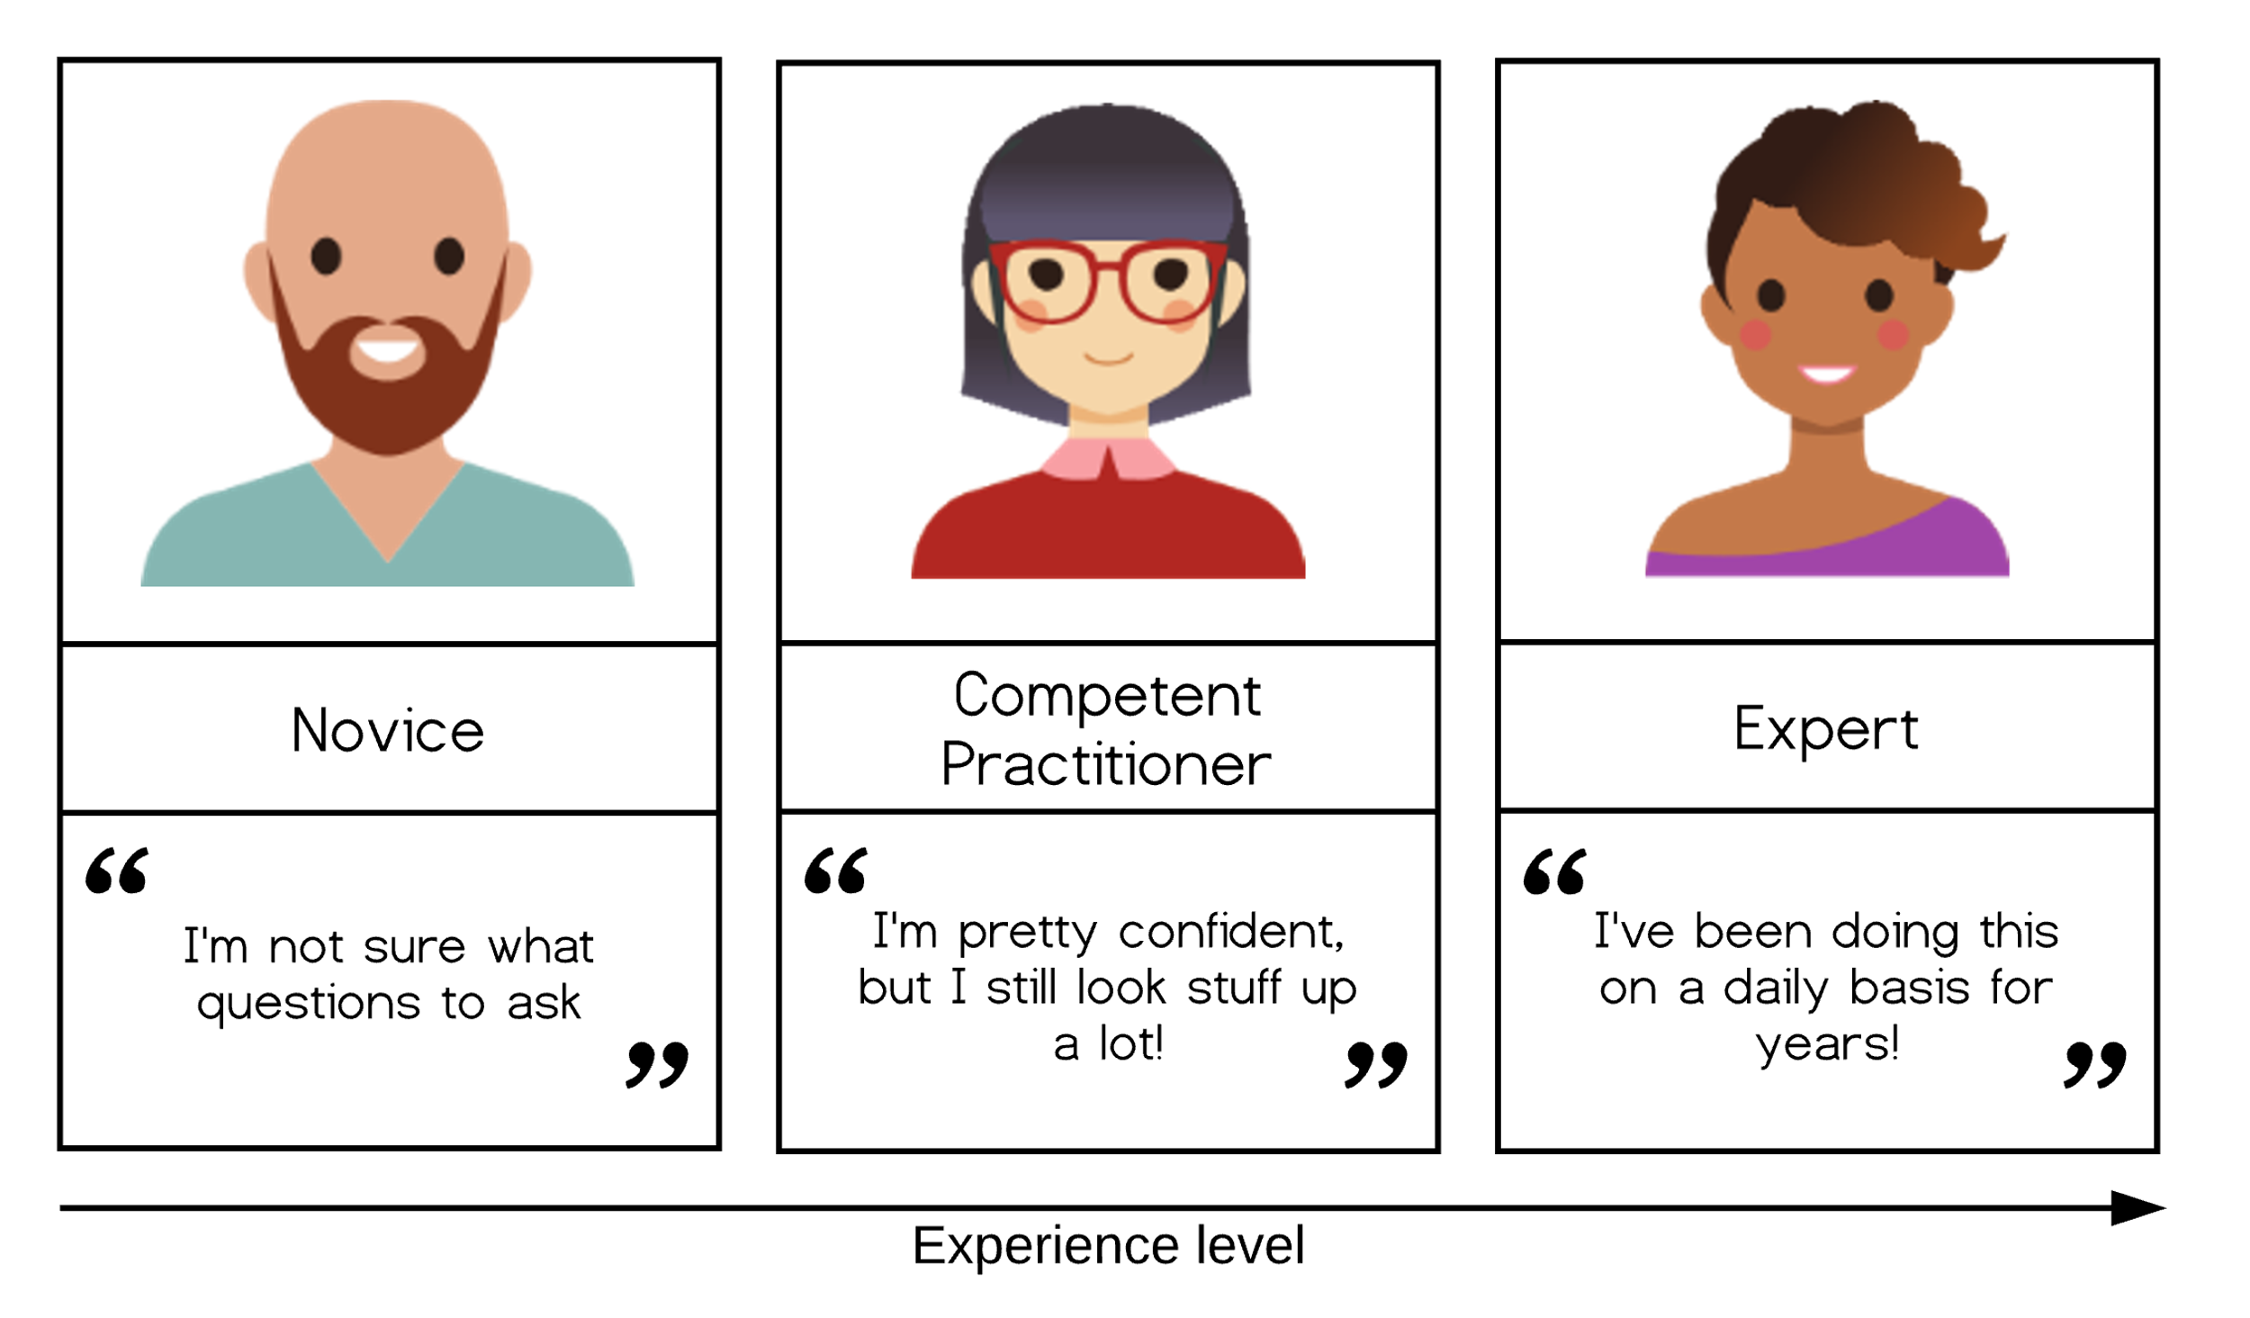
What does success look like?
Achieving independence in research computing doesn’t mean you know everything!
Becoming an HTC Practitioner
Understand core concepts
Know what questions to ask (how to Google!)
Can use documentation to solve problems
See more in Appendix A
https://carpentries.github.io/instructor-training/02-practice-learning.html
Notes:
https://www.dotkam.com/2007/05/07/the-seven-stages-of-expertise-in-software-engineering/

Slide 10
Becoming a Practitioner
In general:
Building mental models of the topic
Lots of practice, learning from mistakes
Looking at examples
Mentorship from other practitioners
At the OSG School:
Lectures on big picture concepts (with analogies, examples)
Linux concepts: files, directories
Examples of HTC problems
Translate a computational problem into an HTCondor job
Software and data concepts
Hands on exercises
Consultations and support from staff

Slide 11
Planning Today and Tomorrow
What would help you make the jump to “practitioner” in the next two days?
Fully implement a single job?
Scaffold a large submission
Run through multiple examples?
Ask questions of staff?
Lots of work time this morning and afternoon
The rest of this presentation will cover some best practices to guide your next steps.

Slide 12
Best Practices in HTC

Slide 13
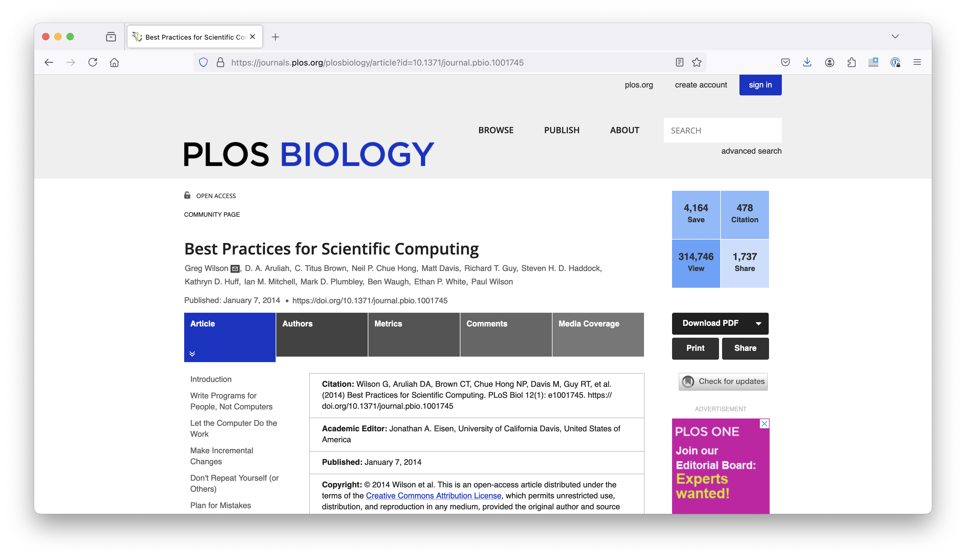
Best Practices for Scientific Computing
https://journals.plos.org/plosbiology/article?id=10.1371/journal.pbio.1001745
More in Appendix G

Slide 14



Optimize Software Only after It Works Correctly
1. Run a single job. | 2. Test a workload of 5-10 jobs. | 3. Scale up to 100s-1000s of jobs

Slide 15
Stage 1: Run a Single Job
For each job type, get a test job working reliably & tune resource needs
Assemble job components: executable, inputs, arguments, etc.*
Estimate initial resource needs*
Write a submit file
Submit!
Review all outputs, including log, output, and error files, Check actual resource usage and update resource needs*
Repeat until (fairly) accurate and reliable
* More details on next slide and in Appendix B

Slide 16
Stage 1: Tips for Initial Test Jobs
Select smaller data sets or subsets of data for your first test jobs
Request 1 CPU, 4-16GB of RAM, estimate disk
Pick test jobs that will reproduce results, if possible
Name files carefully (more on this later)
Make sure you understand and can run your software
Software — executable, dependencies, maybe a wrapper script to prepare environment
Command-line arguments
Input files

Slide 17
Stage 2: Run a Small Workload
Scale up to ~10 jobs, checking reliability & Access Point resource demand
Try a representative variety of arguments and input files
Start developing methods for checking results of all jobs
Checking 1 job is easy; checking 10 is tedious; checking 1000s by hand?
Estimate total resource needs (quotas) for the Access Point itself
Repeat tests at this scale until issues are fixed & resources are accurate

Slide 18
Stage 3: Scale Up!
Continue scaling up in 10–100× increments, checking for & fixing issues
As you scale up, a challenge is to distinguish among:
Real issues with your jobs
Real issues with SOME of your jobs
Temporary issues with the OSPool/Access Point
Bugs and other longer-lasting issues with the infrastructure
(We can help! Email us with support requests if you get stuck.)
Think about the best practices from the following slides.

Slide 19
Bonus: Organization and Naming
A naming and/or organization strategy:
Makes other best practices (like automation and reproducibility) easier
Reduces cognitive load!
Intention and consistency more important than “ideal” setup
Take five minutes of your time and review this amazing talk by Jenny Bryan for inspiration: http://www2.stat.duke.edu/~rcs46/lectures_2015/01-markdown-git/slides/naming-slides/naming-slides.pdf
(Version 2, from 2022: https://github.com/jennybc/how-to-name-files)

Slide 20
Don't Repeat Yourself (or Others)
Christina’s rule of thumb: If I have copy + pasted something more than twice, it should be a variable.
#!/bin/bash
condor_status -const 'Gpus > 0' >> 2024-08-08-gpus.txt
diff ref.txt 2024-08-08-gpus.txt >> 2024-08-08-gpus.txt.diff
#!/bin/bash
DATE=2024-08-08
RESULT=${DATE}-gpus.txt
condor_status -const 'Gpus > 0' >> $RESULT
diff ref.txt $RESULT >> $RESULT.diff

Slide 21
Using Arguments
Another tool for not repeating yourself is adding arguments* to your code – allowing it to be used again without editing.
(Can use a configuration file instead)
./gpu-diff.sh 2024-08-08
#!/bin/bash
#$1 is how bash notates the first argument to a script
DATE=$1
RESULT=${DATE}-gpus.txt
condor_status -const 'Gpus > 0' >> $RESULT
diff ref.txt $RESULT >> $RESULT.diff
See Appendix D

Slide 22

Let the Computer Do the Work
For jobs: HTCondor 😇
For workflows: DAGMan (up next!)
For many other tasks: scripting in your language of choice (bash, python, perl)
https://www.teepublic.com/t-shirt/3810999-go-away-or-i-will-replace-you-with-a-very-small-sh

Slide 23
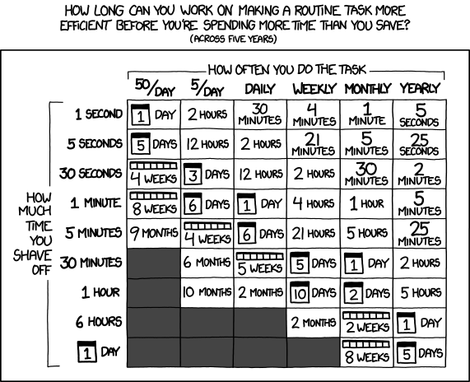
How much to automate?
Depends on how much work you want to do!
Things to consider automating:
Uploading and downloading files
Checking for errors
Reviewing job information (run times, memory usage)
Consider the trade-off of time to automate vs time saved
More details in Appendix E
https://xkcd.com/1205/ (the chart above)
https://xkcd.com/1319/ (less optimistic)

Slide 24
Plan for Mistakes
Where can jobs go wrong?
Job starting
Transfer of input files
Execution of code (lots of things can go wrong here) / generating outputs
Transfer of output files
How do you know when things go wrong?
How can you spot-check your results for correctness?
(Again, automation may be your friend)

Slide 25
Job Debugging Tips
Add print or echo statements to your scripts or code (will print to the standard output file)
Also, date! ls! pwd!
Standard error file has error messages
Google these!
The more generic the error, the harder to troubleshoot
Log file has hold reasons and job states/timestamps
Use HTCondor’s list of job attributes
More in Appendix F

Slide 26
Document Design and Purpose
Have a place for notes
Lab notebook
Word or Google document
Markdown file
Add comments to submit files and scripts
A little is better than nothing!!

Slide 27
Make incremental changes
NO NEED TO REWRITE ALL YOUR CODE. Make one small change at a time.
Which of the previous practices would be most useful to you?
Example of little changes:
Implement a naming scheme
Implement an organizational scheme
Add arguments to a script
Automate one (1) thing

Slide 28
Reflection

Slide 29
Learning HTC
What does “independence in research computing” mean to you?
When learning something new what resources out in the world have been transformative for you in becoming an independent practitioner? What made you feel part of a community?
Did you know about our guides? How could we make them more “findable?” Which is most useful (in your opinion)? What is missing?

Slide 30
Implementing HTC
What components do you need for your HTC workload?
Scaling Up
Where are you in the scaling up process?
What are three things to consider in your current stage?
What organizational strategy makes sense for the next steps in your analysis?
Consider the balance between human effort (yours!) and computer time; will the use of HTC actually save you time in the long run and improve your research?

Slide 31
Questions

Slide 32
Appendix A: Practitioner
There are many people who have thought about how to gain skills and become a practioner.

Slide 33
Various Ways to Think about Competency
Great seven step summary: https://www.dotkam.com/2007/05/07/the-seven-stages-of-expertise-in-software-engineering/
Carpentries Instructor Training Material: https://carpentries.github.io/instructor-training/02-practice-learning.html
https://en.wikipedia.org/wiki/Four_stages_of_competence
https://en.wikipedia.org/wiki/Dreyfus_model_of_skill_acquisition

Slide 34
Appendix B: Scaling Up
Additional tips for each stage of the scaling up process

Slide 35
Stage 1: Tips for Initial Test Jobs
Test one of each kind of job you will run (e.g., prep, simulation, analysis)
Select smaller data sets or subsets of data for your first test jobs
Pick test jobs that will reproduce results, if possible
Name files carefully
Make sure you understand and can run your software
Software — executable, dependencies, maybe a wrapper script to prepare environment
Command-line arguments
Input files

Slide 36
Stage 1: Estimating Initial Resource Needs
CPU
By default, start with 1
Unless you know for sure that you executable uses a certain number > 1
Memory
Start with the total memory available on laptop or where it ran before
It’s ok if this is a lot the first time, you will fine-tune later
Disk
Estimate (as best you can) and sum sizes of: executable (+ environment), input files, output files, temporary files, standard output/error

Slide 37
Stage 1: Run, Refine, Repeat
After running a test job:
Check logs and output for errors, warning, holds, etc.
Check HTCondor job log for actual resource usage
Fix issues, update resource needs, run 1 job again!
005 (1234.000.000) 2022-07-28 09:12:34 Job terminated.
(1) Normal termination (return value 0)
[...]
Partitionable Resources : Usage Request Allocated
Cpus : 1 1
Disk (KB) : 40 30 4203309
Memory (MB) : 1 1 1

Slide 38
Stage 2: Try Various Inputs
For Stage 1, the suggestion was to keep things short and simple
For Stage 2, it is time to explore the entire range of inputs to your jobs
Different command-line arguments; e.g., start, middle, and end of parameter sweep
Different input files; e.g., small, medium, and large — whatever makes sense for you
As you explore, you may find that per-job resource needs vary
Set your resource requests a bit higher than maximum observed usage
For example, if 10 test jobs used between 938 MB – 1.23 GB of memory, update your submit file to request 1.5 GB memory
After any changes, run the same test again and re-evaluate

Slide 39
Stage 2: Checking Results of Multiple Jobs
Start developing methods for checking the results of multiple jobs
Output from your executable (i.e., your research results)
Debugging output: standard output and error files, executable logs, etc.
HTCondor job log file (log = job.log in your submit file)
This may be one of the most overlooked aspects of scaling up!
Checking 1 job is easy; checking 10 is tedious; checking 1000s by hand? 😭
Techniques include:
Sampling
Developing tools to automate
Sounds a bit like research, right? You know how to do that…

Slide 40
Stage 2: Estimate Access Point Needs
Do not forget about your Access Point – it is a shared resource, too!
Storage space for files
Based on a run of 10 jobs, estimate total number and size of all files for full production
Do you have enough storage space on the Access Point? If not, what options exist?
Number of running jobs
In theory, how many jobs could you have running at once?
Each running job uses some CPU and memory on the Access Point itself
If submitting over 10,000 jobs consider limiting (throttling) running and idle jobs on Access Point

Slide 41
Stage 3: Iterate in Steps of 10–100×
By now, you have tested tens of jobs, maybe in a workflow; what next?
Continue scaling up in increments of 10–100 times the number of jobs
All the considerations from Stage 2 apply at each increment
Be sure to find, understand, and hopefully fix issues before moving on
As you scale up, a challenge is to distinguish among:
Real issues with your jobs, workflow, resource requests, etc.
Real issues with certain subsets of your jobs
Temporary issues with the HTC infrastructure itself
Bugs and other longer-lasting issues with the infrastructure
We can help! Email us with support requests if you get stuck.

Slide 42
Appendix C: File Organization
A worked example (similar to the exercises) on how you might organize the files in a job submission

Slide 43
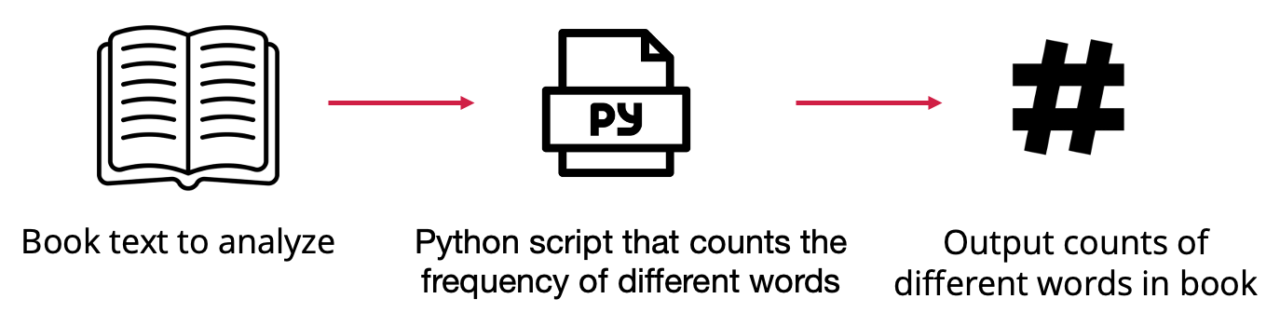

Example: Text Analysis

Slide 44
Organizational Plan For Our Files
wordcount.sub
wordcount.py
input/
Dracula.txt
...
output/
count.Dracula.txt
...
log/
job.0.log
...
errout/
job.0.out
job.0.err
...
We will assume that we want to put our input files (books) in one folder, and our output files (word counts) in another folder.

Slide 45
Organizational Plan For Our Files
wordcount.sub
wordcount.py
input/
Dracula.txt
...
output/
count.Dracula.txt
...
log/
job.0.log
...
errout/
job.0.out
job.0.err
...
There are additional files that will be produced by the job as well that we should consider – the HTCondor log, stdout and stderr. We’ll put these into two folders.

Slide 46
Coordinate HTCondor and File Structure
# submit file name: wordcount.submit
executable = wordcount.py
arguments = Dracula.txt
transfer_input_files = inputs/Dracula.txt
transfer_output_remaps = \
“count.Dracula.txt = outputs/count.Dracula.txt”
log = logs/$(ProcId).log
error = errout/$(ProcId).err
output = errout/$(ProcId).out
queue 1
wordcount.sub
wordcount.py
input/
Dracula.txt
...
output/
count.Dracula.txt
...
log/
job.0.log
...
errout/
job.0.out
job.0.err
...

Slide 47
HTCondor Options for Organizing Files
Syntax | Purpose | Features
Transfer_output_remaps = “file1.out=path/to/file1.out; file2.out=path/to/renamedFile2.out” | Used to save output files in a specific path and using a certain name | - Used to save output files to a specific folder - Used to rename output files to avoid writing over existing files
Initialdir = path/to/initialDirectory | Sets the submission directory for each job. When set, this is becomes the base path where output files will be saved. | - Used to submit multiple jobs from different directories - Used to avoid having to write some paths in other submit file values
More Information: https://htcondor.readthedocs.io/en/latest/users-manual/file-transfer.html

Slide 48
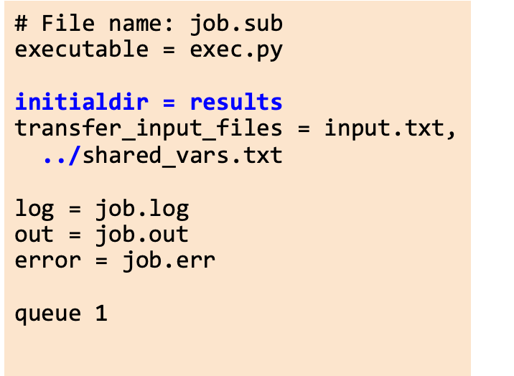
Return Output to Specified Directory with InitialDir
submission_dir/
job.sub
exec.py
shared_vars.txt
results/
input.txt
output.txt
job.err
job.log
job.out

Slide 49
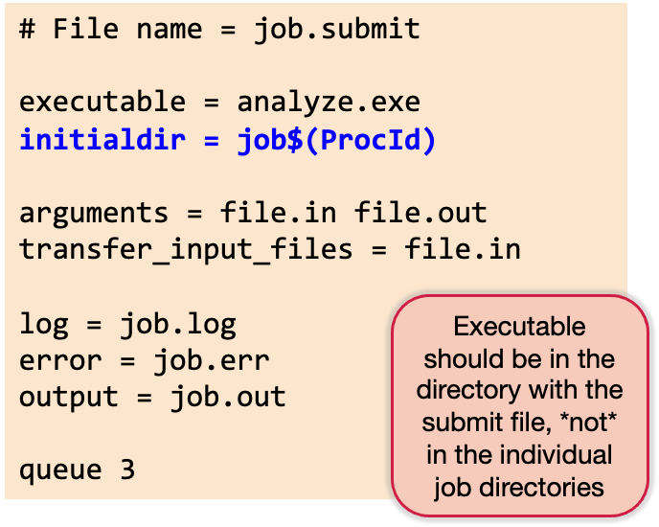
Separate Jobs with InitialDir
submission_dir/
job.submit
analyze.exe
job0/
file.in job.log job.err
file.out job.out
job1/
file.in job.log job.err
file.out job.out
job2/
file.in job.log job.err
file.out job.out

Slide 50
Organizing Data Files
Some HTC systems will have you place small files in one directory and larger files in a different directory.
For example, on ap40 (an OSPool Access Point), we place files less than 1GB in /home and larger files in an OSDF origin.
Once inputs and outputs are placed in the right location, use the appropriate HTCondor file transfer options to move the data to jobs.

Slide 51
Appendix D: Adding Arguments
How to use arguments in R, Python and bash
https://gist.github.com/ChristinaLK/a672cdd5dc0c0664557befb4df69d98e

Slide 52
Arguments in Python
$ python3 args.py 1 hello True
[“args.py”, “1”, “hello”, “True”]
”1”
“results1.csv”
## args.py
import sys
values = sys.argv
print(values)
jobnumber = values[1]
print(jobnumber)
outfile = 'results'+ jobnumber + '.csv’
print(outfile)

Slide 53
Arguments in R
$ Rscript args.R 1 hello True
[1] “1”, “hello”, “True”
[1] ”1”
[1] “results1.csv”
## args.R
values <- commandArgs(trailingOnly=TRUE)
print(values)
jobnumber <- values[1]
print(jobnumber)
outfile <-
paste0('results',jobnumber,'.csv')
print(outfile)

Slide 54
Arguments in Bash (shell)
$ ./args.sh 1 hello True
1 hello True
1
results1.csv
## args.sh
import sys
values=$@
echo values
jobnumber=$1
echo jobnumber
outfile=results${jobnumber}.csv
echo outfile

Slide 55
Appendix E: Automation
General tools that are useful for automating things

Slide 56
Unix Tips and Tricks
Aliases and shell configuration: https://carpentries-incubator.github.io/shell-extras/07-aliases/index.html
SSH configuration (for example: https://chtc.cs.wisc.edu/uw-research-computing/configure-ssh)
Super useful shell commands: cut, grep, sort, uniq, head, tail (plus pipes: https://swcarpentry.github.io/shell-novice/04-pipefilter.html)
Just for fun, see your most commonly used commands with:
cat ~/.bash_history | cut -d " " -f 1 | sort | uniq -c | sort -nr | head -n 20
Scripting! https://swcarpentry.github.io/shell-novice/06-script.html

Slide 57
Appendix F: Job Information
How to get more information about your jobs using HTCondor job attributes and searching through the log file

Slide 58
Job Attributes with condor_q
HTCondor stores a list of information about each job.
This information is stored in this format:
AttributeName = value
You can find a list of attributes for a single job by running:
condor_q -l JobID
You can print out specific attributes by using the “format” or “auto-format” flags with an HTCondor command:
condor_q -af Attribute1 Attribute2
adds job number: condor_q -af:j Attribute1 Attribute2

Slide 59
Interesting Job Attributes
Job identifying information
ClusterID
ProcID
Cmd
Arguments
UserLog
Where it ran
LastRemoteHost
MATCH_EXP_JOBGLIDEIN_ResourceName
Resource Request and Usage
RequestCpus (Memory, Disk)
MemoryProvisioned (Disk)
CPUsUsage (MemoryDisk)
Timing
EnteredCurrentStatus
QDate

Slide 60
Interesting Job Attributes
Codes
JobStatus
ExitCode
HoldReasonCode
HoldReasonSubCode,
NumHoldsByReason
Counts
NumJobStarts
NumShadowStarts
NumSystemHolds,

Slide 61
Checking Completed Jobs
condor_history
Contains finalized job attributes for completed jobs
some have different names (HoldReason --> LastHoldReason)
Easy to use constrain and to display values (like condor_q)
Can be slow to search (latest first) and may drop old records quickly
HTCondor job log files (log = job.log in submit)
Contain a lot of information
That is both a blessing and a curse
Somewhat easy to parse — or use HTCondor Python bindings/other tools to help

Slide 62
HTCondor Job Log Files
One big, combined file, or one per job? Your preference, really
With tens or hundreds of jobs (& more), not practical to review manually
Can try to use the grep command-line tool to find specific lines
Use a tool to summarize log results (logs2csv)

Slide 63
HTCondor Job Log Files: Terminations
To find when every job ended:
$ grep '^005' LOGS
(LOGS can be one file, a list of files, or a glob (using *) of files)
To find termination codes (exit codes) for every job:
$ grep termination LOGS
(will not show job IDs, though)
To get counts by termination code:
$ grep termination LOGS | sort | uniq -c

Slide 64
HTCondor Job Log Files: Resource Lines
To get memory resource lines:
$ grep -h 'Memory (MB) *:' LOGS > memory_resources.txt
To get disk resource lines:
$ grep -h 'Disk (KB) *:' LOGS > disk_resources.txt
Import the resulting files into Excel (with some attention to import options)
For file transfers:
$ grep -h 'Total Bytes Sent By Job' LOGS
$ grep -h 'Total Bytes Received By Job' LOGS

Slide 65
HTCondor Job Log Files: Checking on Holds
To view all job holds, their reasons, and related codes:
$ grep -h -A 2 '^012' LOGS
(Omit the -h option to see log filenames for each hit.)
Note: The OSPool may automatically release (rerun) some held jobs; if you don’t look for them explicitly, you may never know those holds occurred

Slide 66
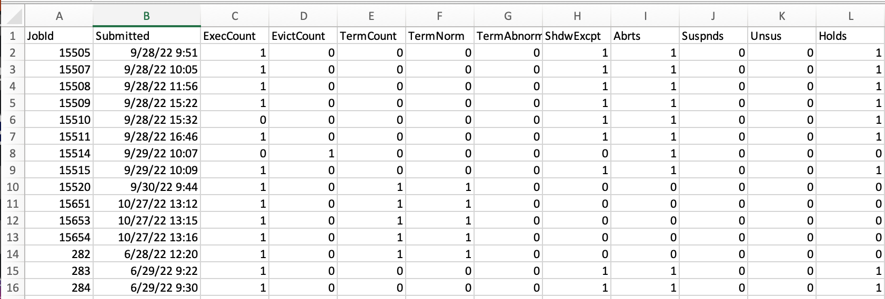
HTCSS Job Event Log to CSV Summarizer
A simple script that reads HTCondor job event logs and outputs a CSV summary of job statistics.
[alice@ap40 logs]$ logs2csv *.log > summary.csv
https://github.com/osg-htc/job-event-log-to-csv

Slide 67
Appendix G: Further Reading
Christina’s favorite references and lessons for general research computing skills and best practices

Slide 68
Reading
So You Want to Be a Wizard: https://wizardzines.com/zines/wizard/
(All of Julia’s zines are amazing!!!!!)
Best Practices for Scientific Computing: https://journals.plos.org/plosbiology/article?id=10.1371/journal.pbio.1001745
Good Enough Practices for Scientific Computing: https://journals.plos.org/ploscompbiol/article?id=10.1371/journal.pcbi.1005510#sec027
10 Simple Rules for Making Research Software More Robust: https://journals.plos.org/ploscompbiol/article?id=10.1371/journal.pcbi.1005412
Naming Files: http://www2.stat.duke.edu/~rcs46/lectures_2015/01-markdown-git/slides/naming-slides/naming-slides.pdf
(Version 2, from 2022: https://github.com/jennybc/how-to-name-files)

Slide 69
Lessons and Books
Software Carpentry/Incubator Lessons:
Unix Shell: https://swcarpentry.github.io/shell-novice/
Shell Extras (not super great, but some useful info): https://carpentries-incubator.github.io/shell-extras/
Version Control with Git: https://swcarpentry.github.io/git-novice/
Docker Intro: https://carpentries-incubator.github.io/docker-introduction/
Research Software Engineering with Python
https://third-bit.com/py-rse/

Slide 70
Acknowledgements
This work was supported by the National Science Foundation under Cooperative Agreement OAC-2030508 – Partnership to Advance Throughput Computing (PATh)

